Slide 1


OPEN SOURCE PLASTIC
RECYCLING MACHINE
Mardi 16 Novembre - Groupe 14
Notes:
WILLIE

Slide 2




Table of contents
A - Context of the Study
B - Problem Statement
C - Main objective of the Project
D - Delivery
E - State of the Art
F - Workplan
Notes:
WILLIE

Slide 3

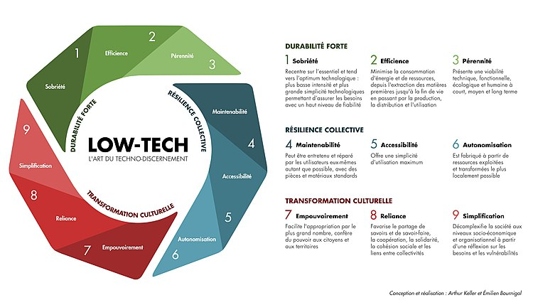


A - Context of the Study
Global context
Open source
Low-tech philosophy
Lot of plastic waste
Few are recycled
An important challenge for the future !
Notes:
MAXIME

Slide 4

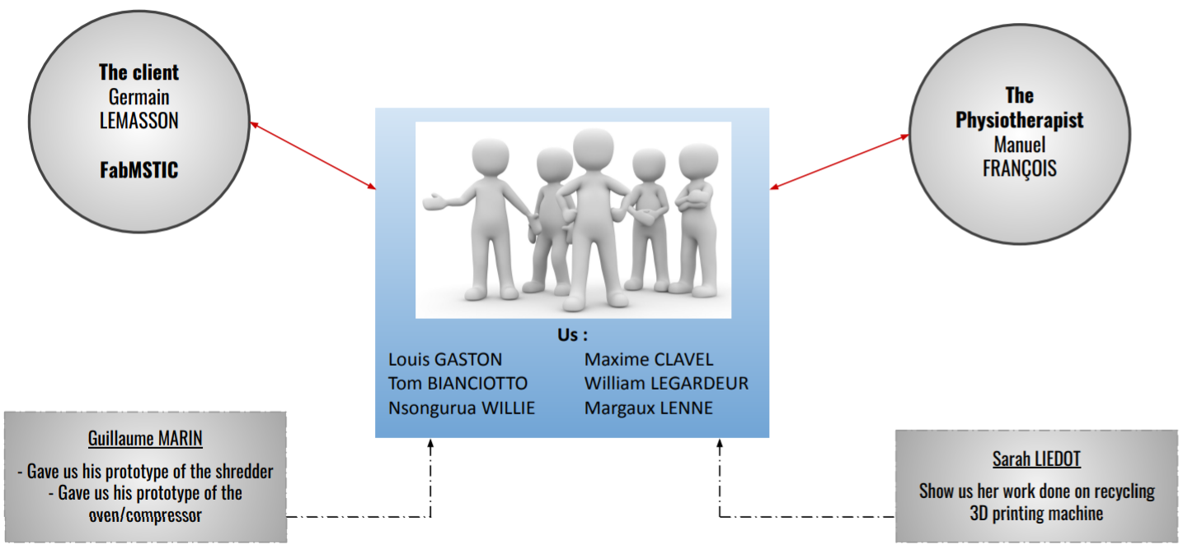
A - Context of the study
Local context
- RAFU : The Grenoble University Manufacturing Workshop Network
- Company CHABLOZ
Overview of the actors of the project
Notes:
MAXIME

Slide 5
Table of contents
A - Context of the study
B - Problem statement
Notes:
MARGAUX

Slide 6
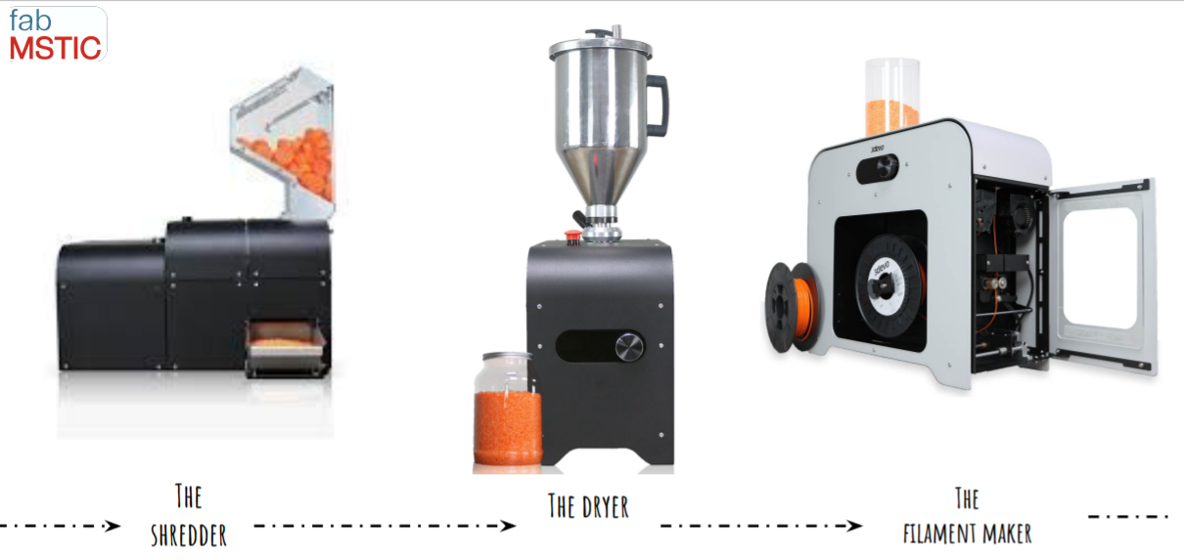
B - Problem statement
Germain LEMASSON’s Challenge (our client)
Machines are very expensive
Hopper of the shredder
Not used often
Our role :
Create an assembly of low-tech solutions for grinding
3Devo recycling solution
Notes:
MARGAUX

Slide 7
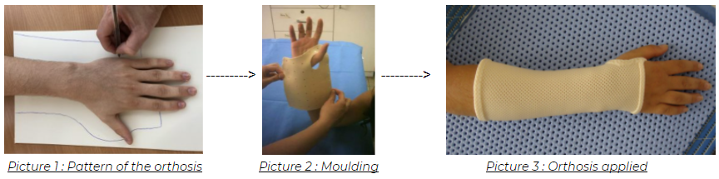
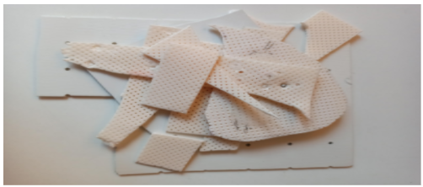
B - Problem statement
The Physiotherapist’s Challenge
Our role :
Make new thermoformable plastic plates thanks to a low tech high temperature press
Picture 4 : Remaining pieces of the
thermoformable plastic plate
Notes:
MARGAUX

Slide 8
Table of contents
A - Context of the study
B - Problem statement
C - Main objective of the project
Notes:
WILLIAM

Slide 9
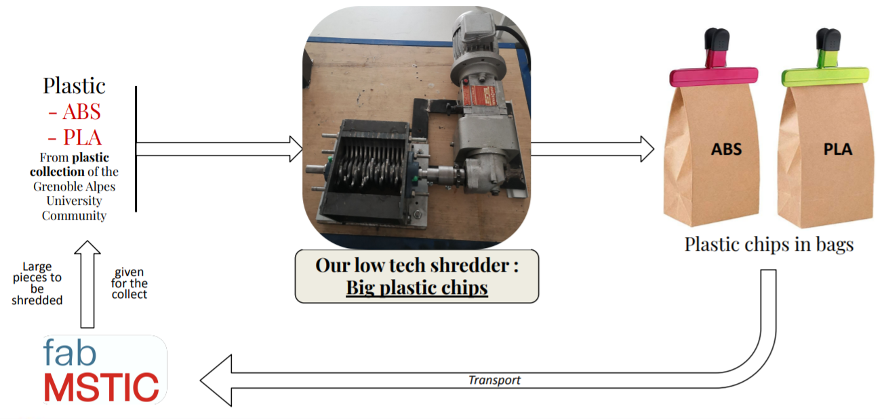
C - Main objective of the project
Objectives for the shredder
SECURITY
ELECTRONIC
SUPPORT
Overview of the project concerning the low tech shredder
Notes:
WILLIAM

Slide 10
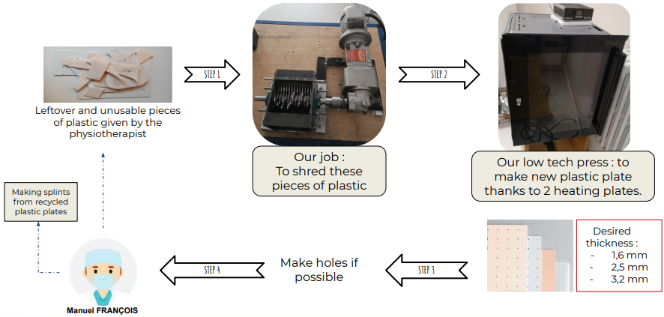
C - Main objective of the project
Objectives for the press
SECURITY
ELECTRONIC
SUPPORT
ENVIRONMENT/HEALTH
Overview of the project concerning the hot press
Notes:
WILLIAM

Slide 11
Table of contents
A - Context of the study
B - Problem statement
C - Main objective of the project
D - Delivery
Notes:
TOM

Slide 12
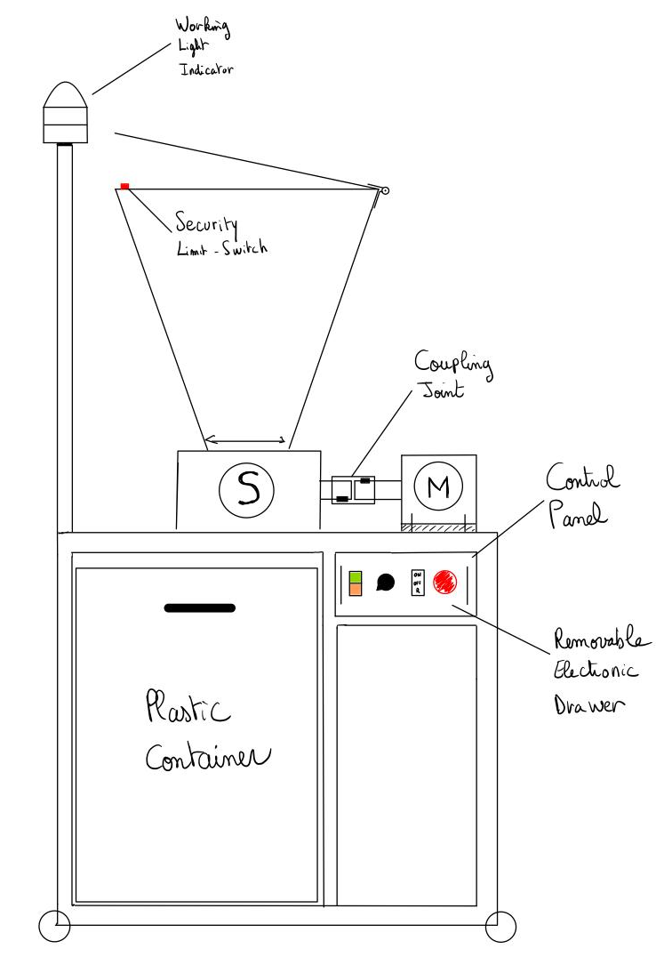
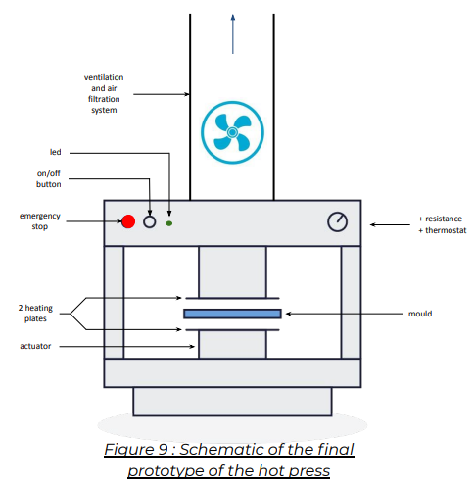
D - Delivery
Schematic of the final prototype of the low tech shredder
Schematic of the final prototype of the low tech hot press
Notes:
TOM

Slide 13
Table of contents
A - Context of the study
B - Problem statement
C - Main objective of the project
D - Delivery
E - State of the art
Notes:
LOUIS

Slide 14
E - State of the art
Plastics | Characteristics | Hazards | Recycling | Sources
PET (PolyEthylene Terephthalate) | Rigid and hard, good mechanical resistance and low moisture absorption | Dangerous for your health! Releases endocrine disruptors into the water | 100% recyclable (but requires purity of recycled material) | Bottles of mineral water, sodas and fruit juices...
PLA (PolyLactic Acid) | Of vegetable origin, Mixture of several plastics |  | Compostable and not biodegradable -> lack of infrastructure to compost it (ends up in the landfill) | 3D printers...
Recycle ≠ plastics
To be the more versatile
Endocrine Disruptors: substances that mimic the role of hormones and disrupt their proper functioning.
... | ... | ... | ... | ...
Notes:
LOUIS

Slide 15
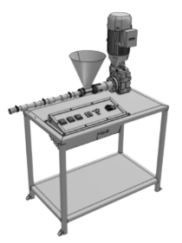
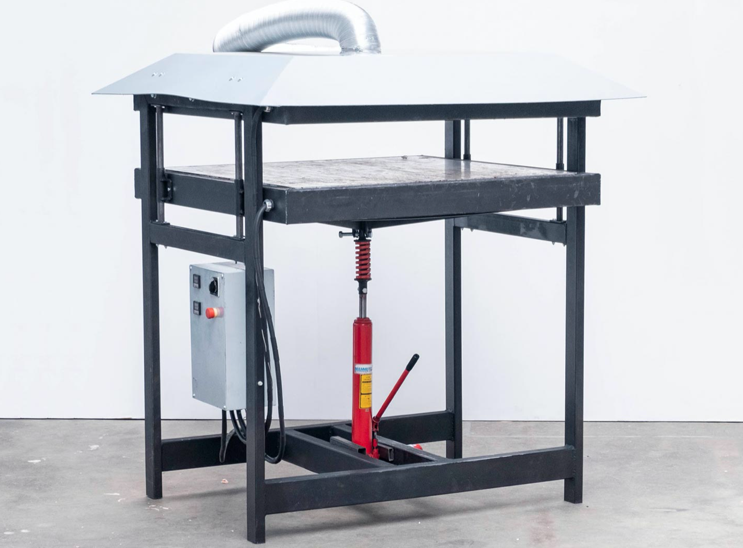
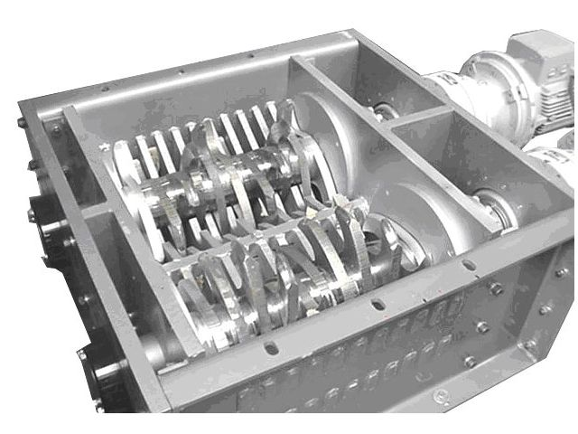
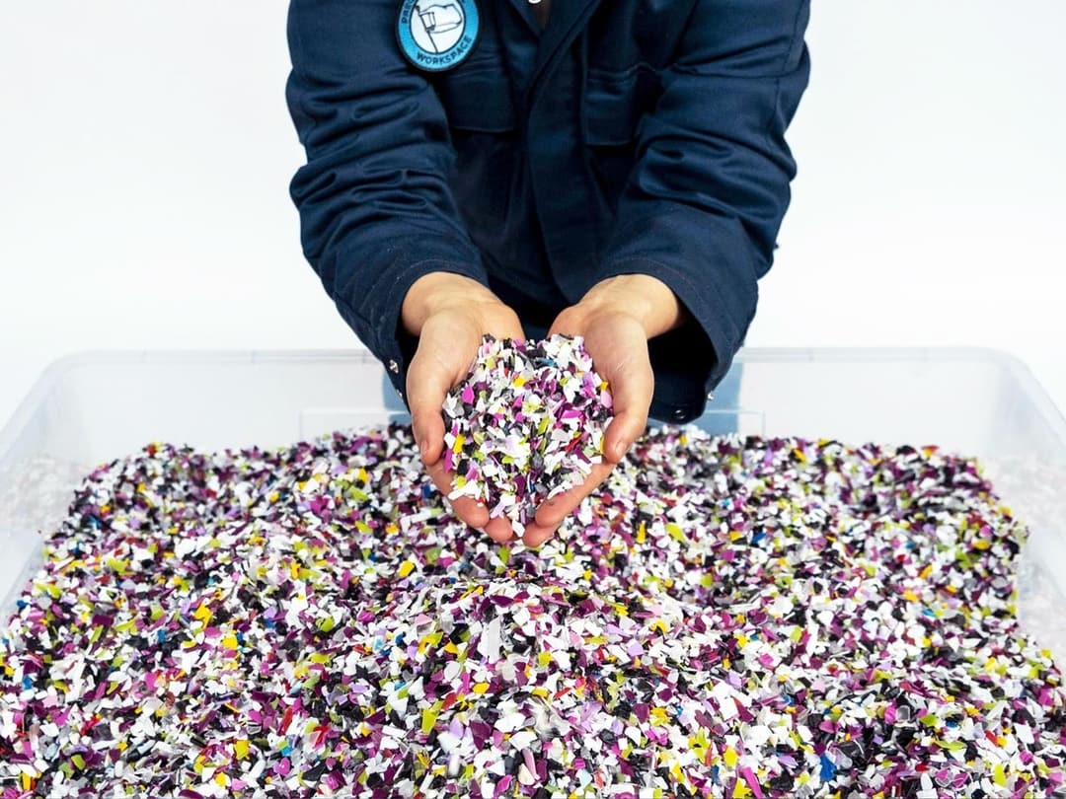
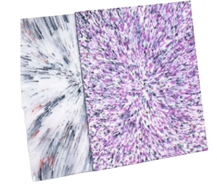
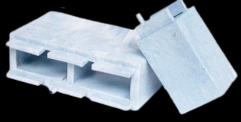
E - State of the art
Shredder
Hot Press
Injection machine
Notes:
TOM

Slide 16
Table of contents
A - Context of the study
B - Problem statement
C - Main objective of the project
D - Delivery
E - State of the art
F - Workplan
Notes:
MARGAUX

Slide 17
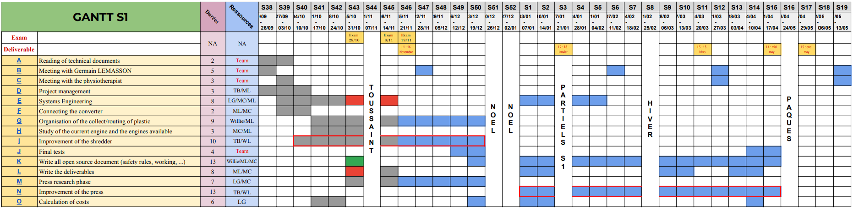
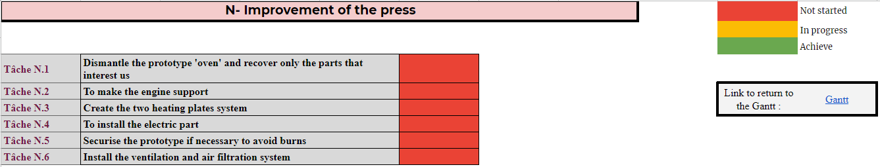
F - Workplan
Notes:
WILLIE

Slide 18
Thank you for your attention
Group 14 :
‘Open Source Plastic Recycling Machine’
BIANCIOTTO Tom
CLAVEL Maxime
GASTON Louis
LEGARDEUR William
LENNE Margaux
WILLIE Nsongurua Innocent
Notes:
WILLIE

